Slide 1
Build’an’Office add-in- using’modern JavaScript tools and techniques
Build an Office add-in using React -

Slide 2

Build an Office add-in using React-
React 101
Building add-ins with React
Side-loading and debugging
Overview of the sample

Slide 3

React 101
React is a component-based JavaScript library maintained by Facebook for building user interfaces. With React, everything is JavaScript, including HTML structures that are expressed via JSX.
React is heavily component-based front-end development with a rich hierarchy of parent/child components to render a UI.
React components are typically written in JSX, a JavaScript extension syntax allowing HTML tag syntax to render subcomponents.
React creates an in-memory ”virtual DOM” computes differences, and then updates the browser's displayed DOM efficiently.
Notes:
We will start our journey into modern client frameworks and add-ins with React. Of all the client-side frameworks, React has a first class ticket for Office add-in developers. You will see that React has a template in the Office Yeoman generator and is highly supported by the Office UI Fabric.
React is a popular component-based JavaScript library built and maintained by Facebook. React leverages a virtual DOM to perform dynamic partial rendering of web content. With React, everything is JavaScript…even markup is represented as JavaScript via JSX. React perhaps most loved for it’s rich hierarchy of reusable components.

Slide 4
React 101 - Sample
class App extends React.Component {
constructor(props) {
super(props);
this.state = { items: [] }
}
render() {
const stocks = this.state.items.map((item, index) => (
<li>{item}</li>
));
return (
<div>
<h1>{this.props.title}</h1>
<div>
<input type="text"
ref="newItem"
onKeyPress={this.add.bind(this)} />
</div>
<ul>{stocks}</ul>
</div>
);
}
add(event) {
if (event.key == "Enter") {
var list = this.state.items;
list.unshift(this.refs.newItem.value);
this.setState({items: list});
this.refs.newItem.value = "";
}
}
}
ReactDOM.render(<App title="Hello World!" />,
document.getElementById("app"));
Points of interest
Sample create an App component with title property
Component rendered to a DOM element
Component’s render function adds child elements (JSX)
Component can have only one root element (can wrap in div)
Component has custom properties
Items bound to component state are two-way bound
Events are bound with function.bind syntax (see input)
Models are represented as a ref on the component (see input)
NOTE: This sample demonstrates just a small fraction of React. It is meant to outline a few basic patterns of that framework.
Notes:
Here is a very basic “Hello World” React application. Although just a fraction of React’s capabilities, this highlights some key concepts and is something you could copy this into Codepen.io and run it.
This sample creates an “App” component that has a single “title” property.
The very bottom of the sample shows how we use React to bootstrap this App component to an element in the DOM
Notice how the render function returns markup (specifically JSX)
You will notice reference to both props and state. Properties are just that…properties of the component, while state is sort of an in-memory property. I say in-memory because the state is live bound…you update it and the element immediately updates

Slide 5

Building add-ins with React – Project Setup
New projects
Use the Office Yeoman generator to provision a new Office add-in project using the React template option
Existing projects
Run the Office Yeoman generator to provision the add-in manifest
Add dependencies to Office.js and the Office UI Fabric via package.json and npm
Convert the application to run with SSL (varies by project)
Update the application entry for Office to boostrap the root component from within Office.initialize
Add office.js and Office UI Fabric references to the markup page(s) (or make modifications to include them in the webpack config)
Notes:
There are two approaches for building Office add-ins with React…build a project or convert an existing project
For new project, the Office Yeoman generator has a great React template that you can leverage to immediately get going.
For existing projects that need to be converted, you can still use the Office Yeoman generator to generator the add-in xaml manifest. You also need to convert the web application to use SSL as add-ins won’t load from a normal http page…they must be https. Depending on the existing solution, this might be as simple as flipping an SSL flag but at worst involve creating a self-signed certificate. You also need to add references to Office.js and the Office UI Fabric React.

Slide 6
Office.initialize and React
// Bootstrap root component in Office.initialize
Office.initialize = () => {
render(
<App title={title} />,
document.querySelector('#container')
);
};
Notes:
One of the most important aspects of using a modern client-side framework with Office add-ins is how the framework is bootstrapped to the markup. Every page that loads in the add-in must call Office.initialize before running other scripts. It is a best practice to bootstrap the main React component to the DOM WITHIN the Office.initialize callback as seen here.

Slide 7
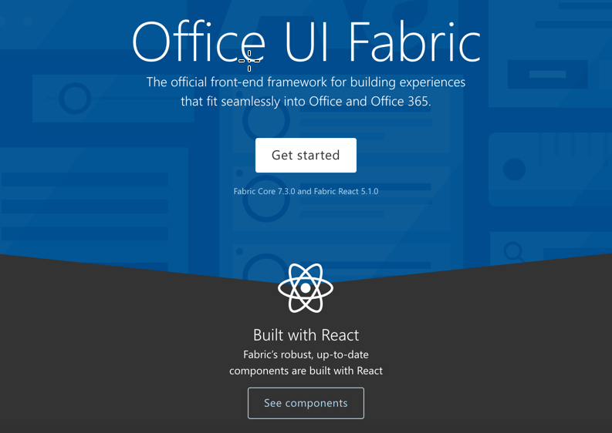
Building add-ins with React – Office UI Fabric React
Office UI Fabric React
Includes 40+ robust and up-to-date components built with the React framework
Integrate easily using office-ui-fabric-react npm package
Typing available for TypeScript projects
Office UI Fabric Core
Includes styles, icons, typography, brand icons, colors, grids, and more
Notes:
React applications are perfectly positioned to use the Office UI Fabric. In fact, all of the Office UI Fabric components are built with React and even have typings for TypeScript. You will see a few of these components leveraged in the demonstration

Slide 8
Side-loading and debugging
Side-loading (All environments)
Start the web host
Ensure your browser will accept the SSL certificate
Create a new Office Online document
Upload the manifest through the insert Office add-in dialog
Side-loading (Win32 Office Client)
Create a local share in the file system
Copy your manifest file to this local share
Open the Win32 Office client
Add the local share to the Trusted Add-in Catalogs in the Trust Center > Trust Center Settings menu
Debugging in Office Online
Leverage the browser developer tools (F12) for debugging
Debugging in Win32 Office from Visual Studio
Open the menu in the top right corner of the task pane
Select Attach Debugger to launch the Visual Studio Just-in-Time Debugger
Notes:
For side loading and debugging React add-ins, you have different options based on your developer environment. Office Online is available to all developer environments and involves uploading the add-in xml manifest through a new Office document in Office Online (via OneDrive). Debugging can be done with the browser developer tools.
For Windows users, you can side load the add-in by creating a local network share, placing the add-in xml manifest in that share, and configuring the Office Client to look for add-ins in this location (via the Trusted Add-in Catalog settings of Trust Center). Visual Studio users can even attach a debugger to task pane add-ins running in the Win32 Office client.

Slide 9
Demo
Notes:
In this demo, we will create a new React add-in using the Office Yeoman generator and look at the use of the Office UI Fabric
1. Open the Demo/Lab markdown for this section in the module
2. Complete the Provision the Office add-in and Side-load the Office add-in steps
3. Update the code in Office.initialize to update the A1 cell of the worksheet:
await Excel.run(async (context) => {
var sheet = context.workbook.worksheets.getActiveWorksheet();
var range = sheet.getRange("A1:A1");
range.values = [["Hello World"]];
await context.sync()
});
4. Return to code and open src/components/progress.tsx and show how the Spinner component from Office UI Fabric React is used.
5. Run the complete solution located in the Demos/01 Build Add-in using React folder
Stop the server on the previous steps
Clone
Run npm install
Run npm run start
Side-load the add-in (or just refresh the one already running as it uses the same port)

Slide 10

Summary
The Office Yeoman generator includes a React template to get started quickly
You must bootstrap rending the root React component inside Office.initialize
Office UI Fabric React has 40+ components that are easily integrated into a React solution

Slide 11
Reading further
Build an Excel add-in using React
https://docs.microsoft.com/en-us/office/dev/add-ins/quickstarts/excel-quickstart-react
Use Office UI Fabric React in Office Add-ins
https://docs.microsoft.com/en-us/office/dev/add-ins/design/using-office-ui-fabric-react
Side-loading Office Add-ins for testing
https://docs.microsoft.com/en-us/office/dev/add-ins/testing/create-a-network-shared-folder-catalog-for-task-pane-and-content-add-ins
Side-loading Office Add-ins in Office Online for testing
https://docs.microsoft.com/en-us/office/dev/add-ins/testing/sideload-office-add-ins-for-testing

Slide 12
Thank you

